Slide 1
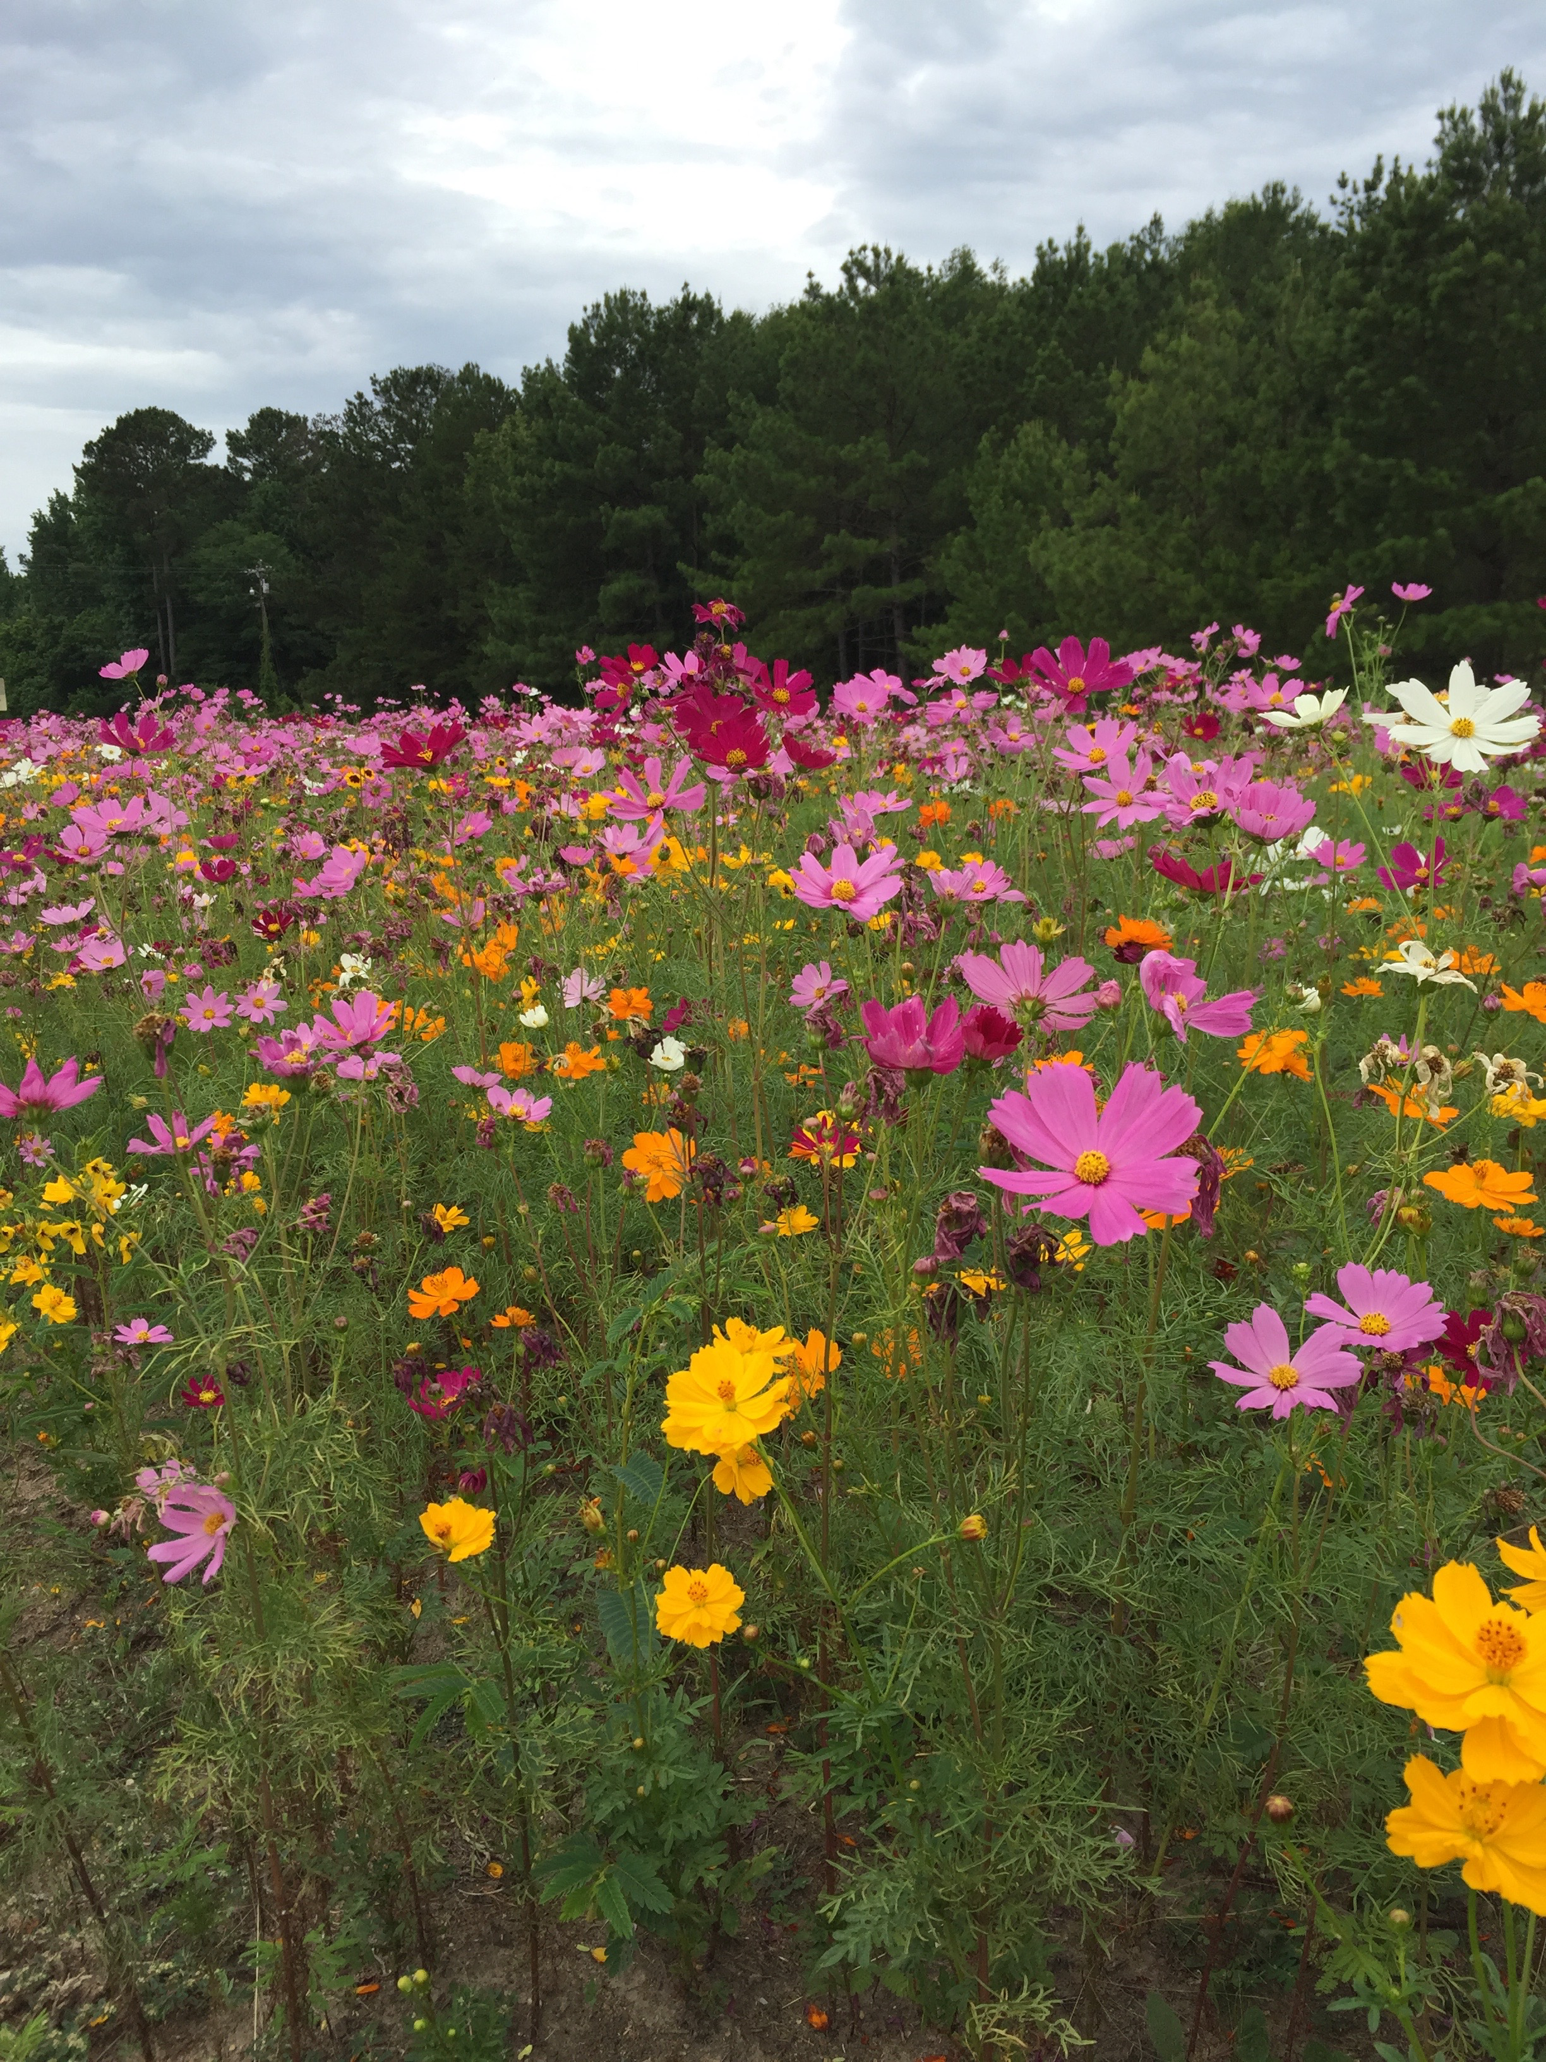
Wildflower Trails of Mississippi
Mayor Sally Garland,
Crystal Springs, MS

Slide 2
The importance of pollinators and associated native plants to production agriculture and ecosystem form and function cannot be stressed enough.
Pollinators provide pollination services to over 180,000 different plant species and more than 1,200 crops, ultimately adding nearly $217 billion to the global economy.
To help support pollinators and create beneficial habitat, a partnership formed and created The Wildflower Trails of Mississippi.

Slide 3


Our Partners Include

Slide 4
Goals of
The Wildflower Trails of Mississippi
Increase awareness and education of the importance pollinators and native plants and their roles in the environment
Enhance aesthetics through the beauty of wildflowers
Generate tourism and economic development

Slide 5
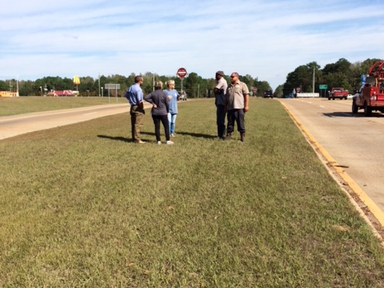
Highway 27 & Highway 51,
Crystal Springs, MS
October 28, 2015

Slide 6
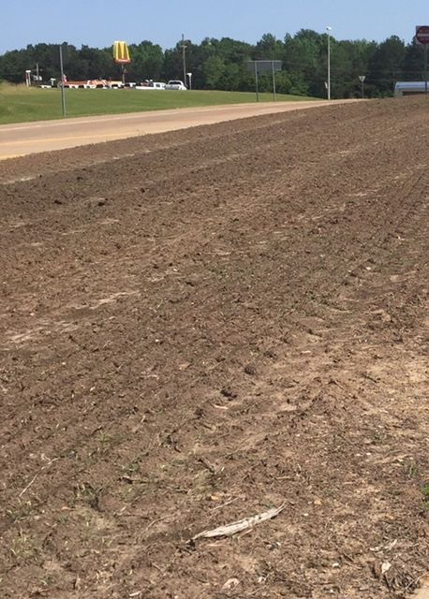
March 2016
After two rounds of herbicide

Slide 7
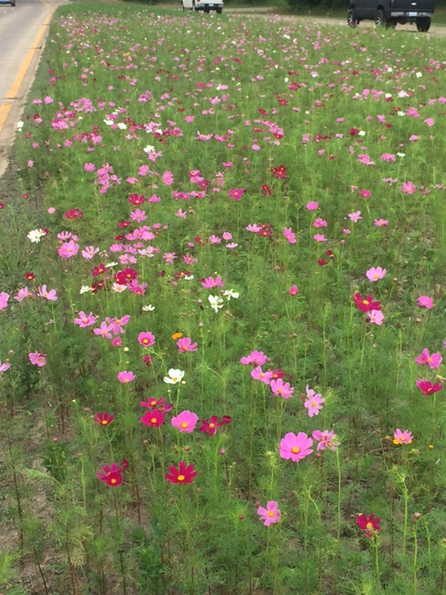
June 1, 2016

Slide 8
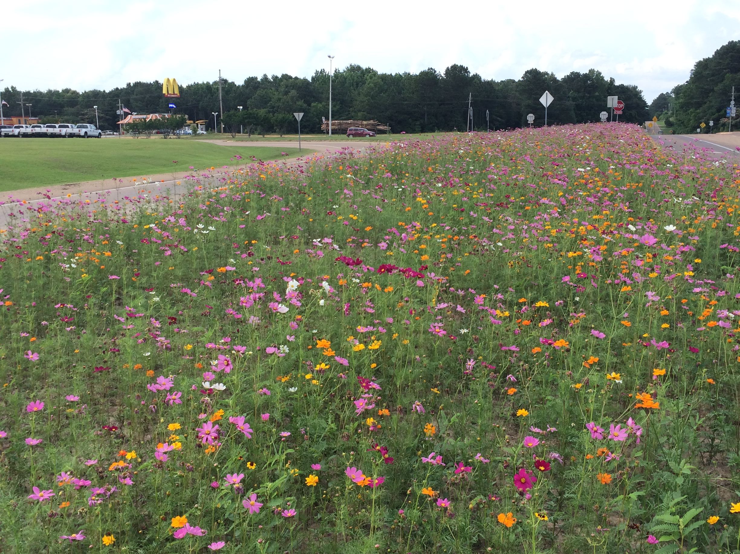
June 12, 2016

Slide 9
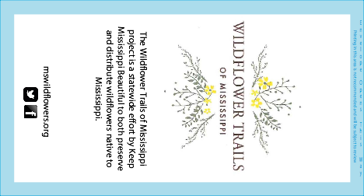
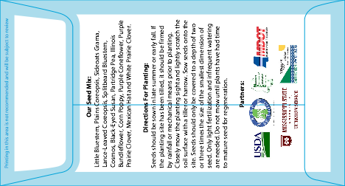
Our Seed Mix
Blooms from Spring to Fall

Slide 10


Slide 11
The Wildflower Trails of Mississippi project is a great way to bring beauty and awareness to public areas and right-of-ways across Mississippi.
Interested municipalities, contractors, right-of-way-managers, and public works employees are encouraged to contact their county MSU Extension office & Keep Mississippi Beautiful office for more information, along with any questions they may have in getting a wildflower area established.
-www.mswildflowers.org
-601.853.4441

